Slide 1
HOTEL BOOKING ANALYSIS
CAPSTONE PROJECT
Presented By:
ESVANTHSAI N- JAYA ENGINEERING COLLEGE- B.E(EEE)

Slide 2
OUTLINE
Problem Statement
Proposed System/Solution
System Development Approach
Algorithm & Deployment
Result
Conclusion
Future Scope
References

Slide 3
Problem Statement
Have you ever wondered when the best time of year to book a hotel room is? Or the optimal length of stay in order to get the best daily rate? This hotel booking dataset can help you explore those questions!
This data set contains booking information for a city hotel and a resort hotel, and includes information such as when the booking was made, length of stay, the number of adults, children, and/or babies, and the number of available parking spaces, among other things.
All personally identifying information has been removed from the data. Explore and analyze the data to discover important factors that govern the bookings.e

Slide 4
Proposed Solution
The Objective of the project to Explore and analyze the data to discover key factors responsible for app engagement and success.

Slide 5
System Approach
Import Libraries: NumPy, Pandas, Seaborn and Matplotlib
Data cleaning: Null values, Finding and removing Outliers, Removing duplicate data.
Exploratory Data Analysis: Analyzing the data sets to summarize their main characteristics using statistical graphics and data visualizations method.

Slide 6
Algorithm & Deployment
Importing necessary packages and libraries.
Mount the drive in colab and read the .csv file.
Analysing the data sheet.
Removing null/NAN/duplicate rows.
Fixing the outliers.
Drop certain columns/combined certain columns to make our data sheet free Avoid of any irrelevant data.
Applying the concept of Data Wrangling and Data Visualization such that we can analyse the data sheet and retrieve required information.

Slide 7
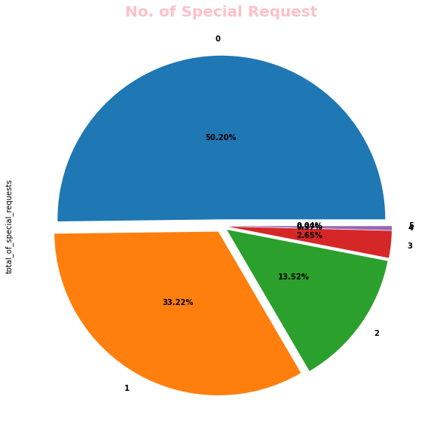
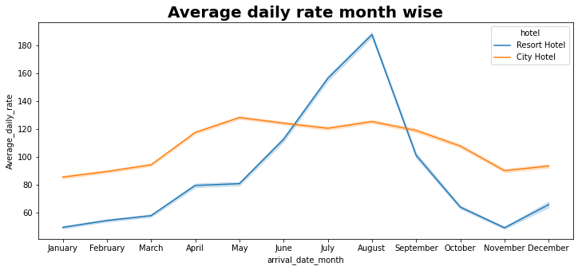
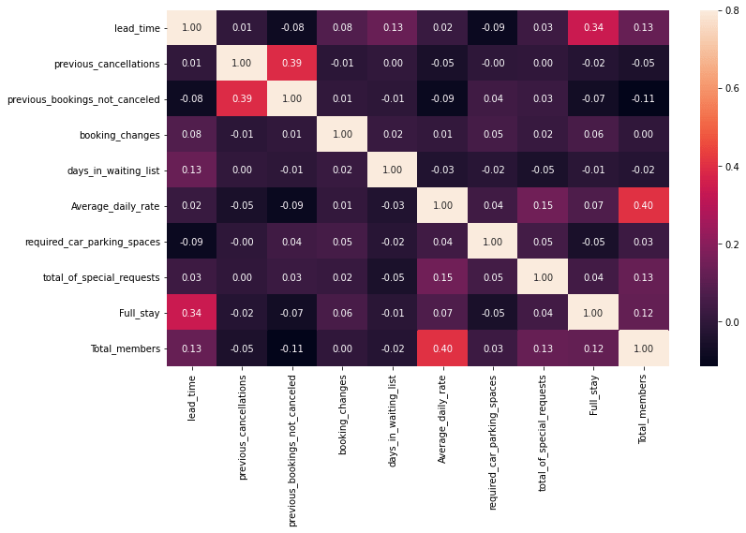
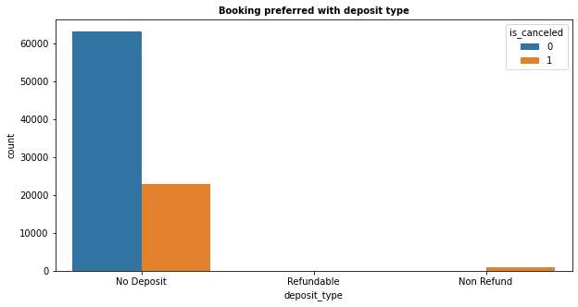
Result

Slide 8
Conclusion
Around 61% bookings are for City hotel and 39% bookings are for Resort hotel, therefore City Hotel is busier than Resort Hotel.
The majority of guests come from western Europe countries. We should spend a significant amount of our budget on those area.
July- August are the busiest and profitable months for both of hotels.
Couples are the most common guests for hotels, hence hotels can plan services according to couples needs to increase revenue.
July and August month have high Average daily price per person for resort hotel.
Most common stay length is less than 4 days and generally people prefer City hotel for short stay, but for long stays, Resort Hotel is preferred.
November,December, February And January are the months which has less booking this period you can get rooms with less average daily rate.

Slide 9
Future scope
In future, it is predictable that ideal speculations to clarify its exhibitions.
In the meantime, its capacities of unsupervised learning will be improved since there is much information on the planet however it isn't relevant to add names to every one of them.
It is additionally anticipated that neural system structures will turn out to be increasingly In addition, profound learning will consolidate with support adapting better and we can utilize these points of interest to achieve more assignments.

Slide 10
References
https://pandas.pydata.org/pandas-docs/stable/index.html
https://www.geeksforgeeks.org/matplotlib-tutorial/?ref=lbp
https://seaborn.pydata.org/
https://matplotlib.org/
Lectures by Almabetter

Slide 11
THANK YOU

